Slide 1




Slide 2

Unit 4: Semi-Supervised Learning
Lecture 6
Submitted by:
Dr Archana Kumari
School of Computer Science UPES, Dehradun
India

Slide 3
Table of Contents
What is Semi-Supervised Learning?
Why Semi-Supervised Learning?
Techniques in Semi-Supervised Learning
Case Study: Semi-Supervised Image Recognition
Challenges in Semi-Supervised Learning
Future of Semi-Supervised Learning

Slide 4
Learning & Course Outcomes
LO1: Understand the definition of Semi-supervised learning and its significance
LO2: Learn about the techniques used in semi-supervised learning.
LO3: Examine specific case studies. Understand practical applications of implementing semi-supervised learning.
LO4: Identify the challenges faced in semi-supervised learning and explorethe future trends
CO2: Understand the basics of Machine Learning and its types.

Slide 5
What is Semi-Supervised Learning?
Definition: Semi-supervised learning involves techniques that use a small amount of labeled data and a large amount of unlabeled data. This method is useful when labeling data is expensive or impractical.

Slide 6
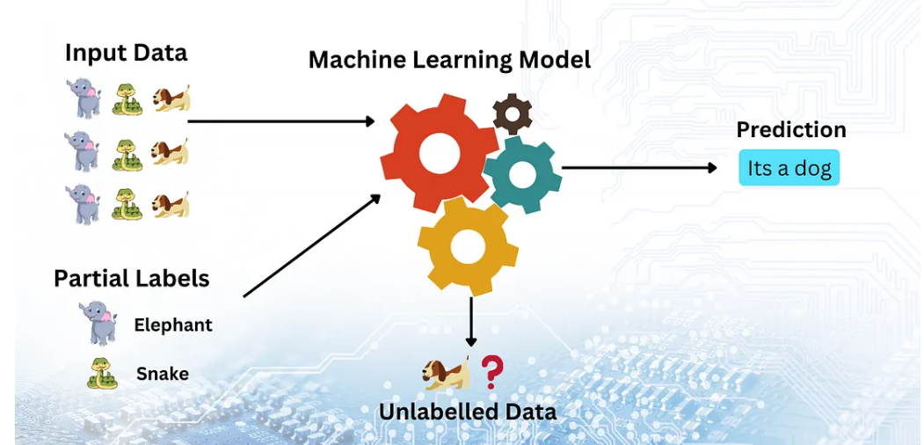
What is Semi-Supervised Learning?

Slide 7
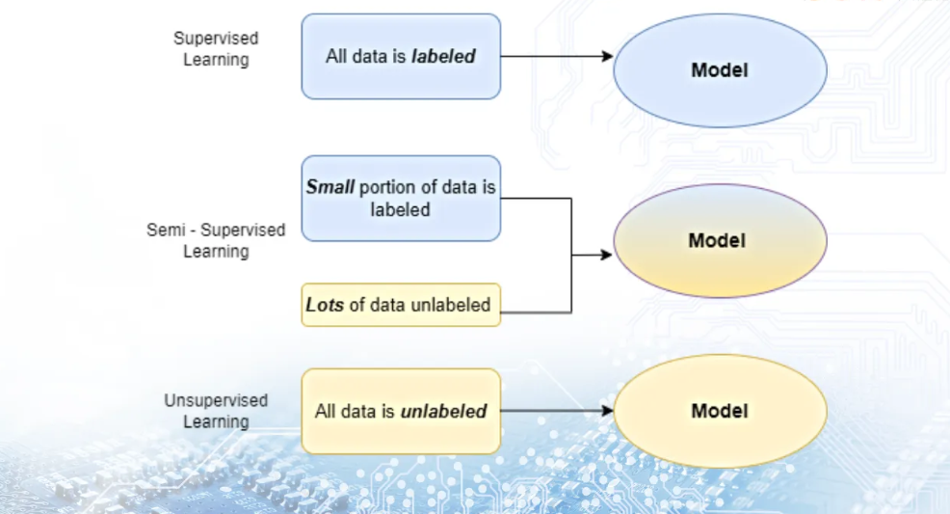
Difference between supervised, unsupervised and semi-supervised Learning

Slide 8
Why is Semi-Supervised Learning?
Graphs/Stats: Provide statistics or case studies showing the improvement in learning accuracy or efficiency when using semi-supervised methods compared to fully supervised methods in data-scarce environments.
Real-life Examples:
Speech Analysis: Semi-supervised learning helps improve voice recognition systems when only limited labeled voice data is available.
Image Recognition: Useful in medical imaging where labeled examples are scarce and costly to obtain.
Web Content Classification: Helps in categorizing web pages or news articles with minimal human intervention.

Slide 9
Techniques in Semi-Supervised Learning
Self-training: A simple approach where a model is initially trained with a small set of labeled data, then uses its predictions to label the unlabeled data, and retrains itself with these new labels.
Co-training: Where two models are simultaneously trained on separate views of the data, helping each other improve by exchanging labels for unlabeled data.
Graph-based methods: These use the relationships between labeled and unlabeled points to propagate labels through the graph.
Generative models: Estimate the distribution of each class in the input space, then use these distributions to infer labels for unlabeled data.

Slide 10
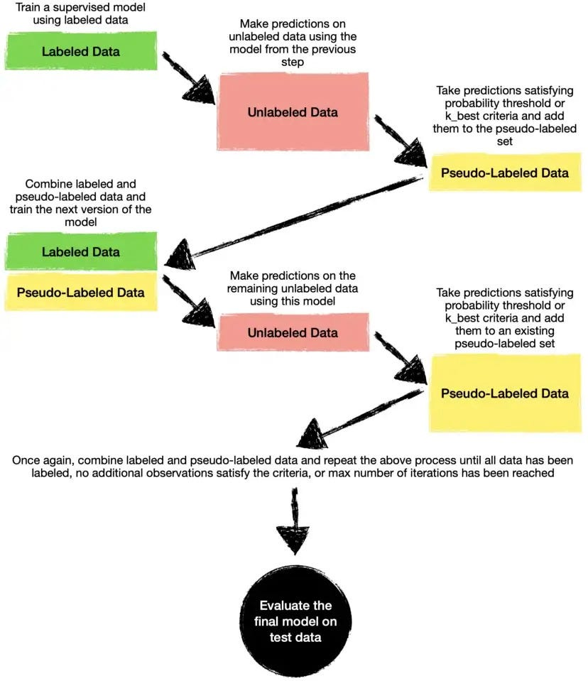
Self-Training

Slide 11
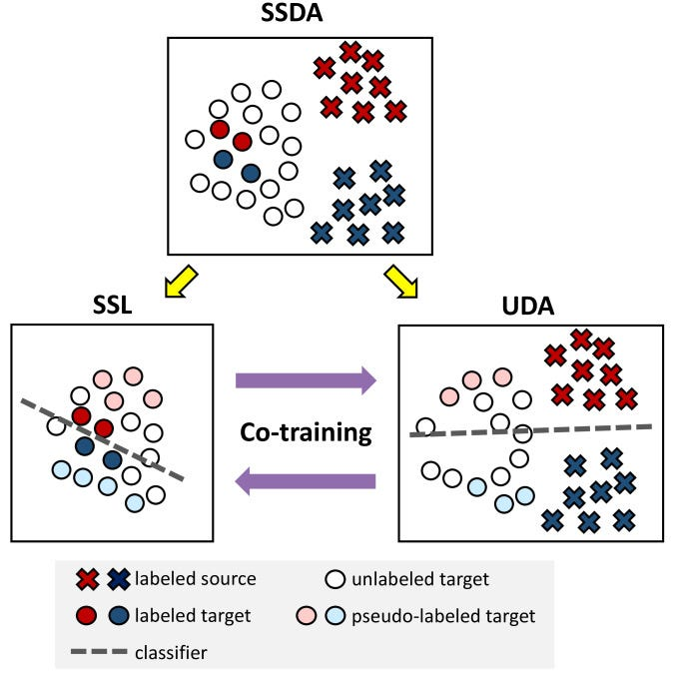
Co-Training

Slide 12
Case Study: Semi-Supervised Image Recognition
Problem Statement: Discuss a real or hypothetical scenario such as identifying diseases from medical images where only a few images are labeled.
Solution Overview: Describe how semi-supervised learning can use both labeled and unlabeled images to improve diagnostic accuracy.
Results: Present hypothetical results showing improvements in accuracy or efficiency.

Slide 13
Challenges in Semi-Supervised Learning
Data Quality: The presence of noisy or irrelevant unlabeled data can mislead the learning process.
Assumptions: Many semi-supervised techniques rely on assumptions like data clustering or manifold structures which might not hold true for all datasets.
Noise Incorporation: The risk of propagating errors through the model as it learns from its own predictions on unlabeled data.

Slide 14
Futures in Semi-Supervised Learning
Trends and Predictions: Highlight the increasing integration of deep learning techniques with semi-supervised learning, expanding its applications.
Visual: A futuristic graphic or diagram showing potential areas of growth and technological development.

Slide 15
Reference Material
Silberschatz, A., Galvin, P. B., & Gagne, G. (2006). Operating system principles. John Wiley & Sons.
https://medium.com/@datasciencewizards/what-is-semi-supervised-learning-a-guide-for-beginners-a7452a597b8c

Slide 16
MCQs
1. What is the primary goal of semi-supervised learning?
A. To only use labeled data for training
B. To improve learning performance using both labeled and unlabeled data
C. To cluster data into groups
D. To maximize the margin between data points
2. Which of the following is a common assumption in semi-supervised learning?
A. The data is uniformly distributed
B. The labeled and unlabeled data share the same underlying distribution
C. The labeled data is more relevant than the unlabeled data
D. The data is linearly separable
3. What is the primary difference between supervised and semi-supervised learning?
A. Supervised learning uses only unlabeled data
B. Semi-supervised learning uses both labeled and unlabeled data
C. Supervised learning uses reinforcement signals
D. Semi-supervised learning uses clustering techniques

Slide 17
MCQs
4. Which of the following statements best describes 'co-training' in semi-supervised learning?
A. It uses multiple models to label unlabeled data iteratively
B. It trains a single model with labeled data only
C. It involves training two models on the same labeled data
D. It is a method used to balance the training dataset
5. Which algorithm is commonly used in semi-supervised learning to leverage both labeled and unlabeled data?
A. K-means clustering
B. Self-training
C. Principal Component Analysis (PCA)
D. Support Vector Machines (SVM)
6. In semi-supervised learning, what is 'self-training'?
A. A method where the model iteratively labels the unlabeled data
B. A clustering algorithm that groups similar data points
C. A method for scaling features before training
D. A type of neural network architecture

Slide 18
MCQs
7. What is a key benefit of using semi-supervised learning compared to purely supervised learning?
A. It requires no labeled data
B. It can achieve better performance with less labeled data
C. It is faster to train
D. It guarantees higher accuracy
8. Which of the following techniques is often used in semi-supervised learning to improve generalization?
A. Data augmentation
B. Label smoothing
C. Pseudo-labeling
D. Gradient clipping

Slide 19
MCQs
9. What is the main challenge in semi-supervised learning?
A. Handling large amounts of labeled data
B. Ensuring the model does not overfit the labeled data
C. Effectively utilizing the information in the unlabeled data
D. Reducing computational complexity
10. Which of the following is a commonly used semi-supervised learning approach in natural language processing (NLP)?
A. Word2Vec
B. Transformer models
C. Bootstrapping
D. LSTM networks

Slide 20
MCQ Answer
1: B. To improve learning performance using both labeled and unlabeled data
2: B. The labeled and unlabeled data share the same underlying distribution
3 :B. Semi-supervised learning uses both labeled and unlabeled data
4:A. It uses multiple models to label unlabeled data iteratively
5:B. Self-training
6: A. A method where the model iteratively labels the unlabeled data
7: B. It can achieve better performance with less labeled data.
8:C. Pseudo-labeling
9: C. Effectively utilizing the information in the unlabeled data.
10: C. Bootstrapping

Slide 21
What’s Next
Applications of AI and Machine learning

Slide 22

Thank You

